Slide 1
Employee Data Analysis using Excel
STUDENT NAM: p.dharshna priya
REGISTER NO: 312211320/ NM ID:asunm1425unm1425sandhyak
DEPARTMENT: B.Com (Commerce)
COLLEGE: Kumararani meena muthiah college of arts and science

Slide 2
PROJECT TITLE
Employee Performance Analysis using Excel

Slide 3


AGENDA
Problem Statement
Project Overview
End Users
Our Solution and Proposition
Dataset Description
Modelling Approach
Results and Discussion
Conclusion
3/21/2024 Annual Review

Slide 4


PROBLEM STATEMENT
EMPLOYEE PERFORMANCE ANALYSIS USING EXCEL
Employee Engagement
Company Growth
Compensation
Motivate low performance employee
Identify strength and weakness of an employee
Employee performance analysis are very important to the company:

Slide 5
EMPLOYEE ENGAGEMENT: 1. Its help to measure how motivated ,passionate ,invested employee are in their job. 2. Its shows company to if they want to change the employee are motivate the old employee to become active in their field so its very useful for the company.
COMPANY GROWTH: Employee performance analysis help company to grow without employee none company can grow. Employees are the foundation of the firm so employee performance analysis shows how employees are working what are the change does company want to do for improvement of company and also increase performance of the employee https://github.com/sandhyak2914/TNSD---DATA-ANALYTICS.git

Slide 6
COMPENSATION:
Compensation in a company increase or motivate ,boost the employee to work more . This analysis helps to find the best employees and provide them the compensation like bonus, increment and other compensation . If they provide compensation they motivate more and they give their best .So employee performance analysis are important to a firm.
MOTIVATE LOW PERFORMANCE EMPLOYEE:
Find the underperforming employee and motive them to improve their overall performance.
STRATEGIES TO IMPROVE:
Provide regular feedback and coaching
Recognize and rewards
Set goals and expectations

Slide 7

PROJECT OVERVIEW
EMPLOYEE PERFORMANCE ANALYSIS USING EXCEL:
EMPLOYEE RATING
EMPLOYEE PERFORMANCE
USING GENDER
ACHIVEMENTS
USING FORMULAES AND FIND THE
PERFORMANCE

Slide 8
WHO ARE THE END USERS?
EMPLOYEE
EMPLOYEER
FIRM
ORGANIZATONS

Slide 9

OUR SOLUTION AND ITS VALUE PROPOSITION
CONDITIONAL FORMATIMG
FILTER
SORT
BAR CHART
IF CONDITION
PIVOT TABLE

Slide 10
CONDITION FORMATING:
We use condition formatting for find out the missing columns and remove it.
First we select the column where there is a blank and fill it with the color and remove it.
FILTER:
we use filter to remove the blank column and filter them with gender also. And also use
Filter to how many people are working in contract, part time and fulltime.
SLICER:
we use slicer to filter employee type.
IF CONDITION:
I don’t have the features of IFS so I check is there any other condition similar to IFS but I don’t found
Such condition so I tried if condition to calculate the employee performance.
PIVOTAL TABLE:
We use pivotal table to show the summary of our project.
BAR CHART:
We use bar diagram to represent our project.

Slide 11
Dataset Description
Employee Data From Kaggle 26 features in employee data
We used 9 features
Employee ID - Numeric
Name - Text
Employee type - Text
Gender - Male / Female
Employee rating - Numeric
Business Unit -Text
Performance - Text
Employee rating - Numeric

Slide 12

THE "WOW" IN OUR SOLUTION
Performance:
I don’t have IFS features so instead I use if condition to
find performance if(=z8>=4,”excellent”,z8<=3,”average”)
3/21/2024 Annual Review
‹#›

Slide 13
MODELLING
DATA COLLECTION
HIGHLIGHT CELLS
DATA CLEANING
PERFORMANCE
PIVOTAL TABLE
GRAPH
‹#›

Slide 14
Data collection:
Download data set from edunet dashboard.
Features:
Hightlight the important cells in excel like
Name
Employee id
Business unit
Employee status
Employee type
Gender
Performance status
Employee rating
Data cleaning:
First find the missing cells
Next using conditional formatting fill the blank cells with color
Next filter the column with no fill
And last we cleaning the data which we don’t want

Slide 15
Performance:
Performance column find it with using the if condition
Select the employee rating column
And apply if condition to the cells
And convert data into text a
And find the performance of the employee
if(=z8>=4,”excellent”,z8<=3,”average”)
Pivotal table:
Use pivotal table for show the summary of the project
Click all the total cells
Create pivotal table
And assign the value to row, column, filter, values.
Row = Business unit
Column = Performance
Values = Name
Filter = Gender
And also use slicer

Slide 16
Visualization:
Use bar diagram for easy access of visualization
Insert performance details for bar diagram
3D Clustered bar
And pie for percentage
And pie for average performance.

Slide 17
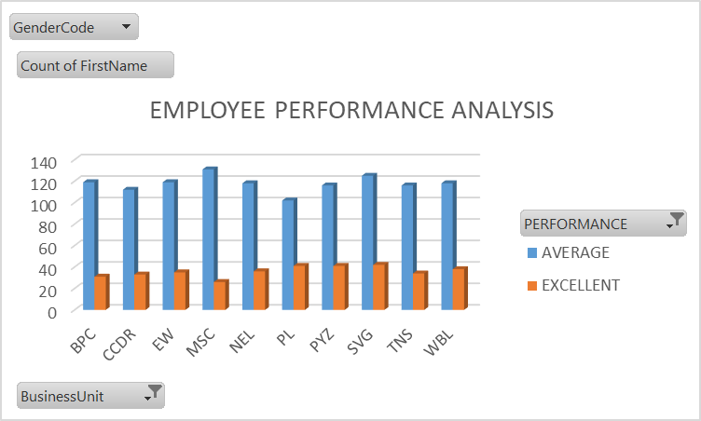
RESULTS
‹#›

Slide 18
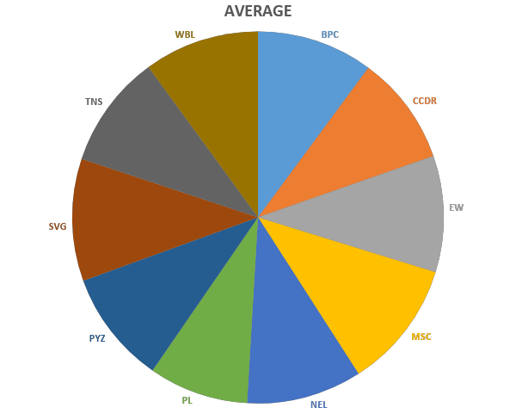
RESULTS

Slide 19
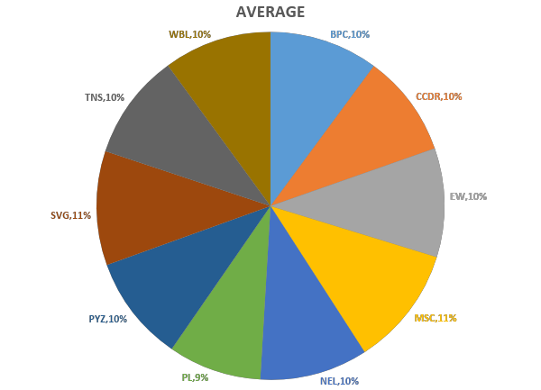
RESULTS

Slide 20
conclusion
In this performance analysis we find most of the employees are average performing category .
Excellent performing employee are low.
We have to improve the underperforming employee to excellent performing employee
We need to motivate and give training to the employee and small reward to
there improvement
In this performance there are 2 companies is very average in performance they have 11%
of average performing employee.
And then there are 6 companies are having 10% of underperforming employee.
And there are 2 companies have only 9% of underperforming employee.
MSC and SVG have 11% .
PYZ, TNS, WBL, BPC, EW and NEL are have 10% .
PL and CCDR have 9% .

